Slide 1

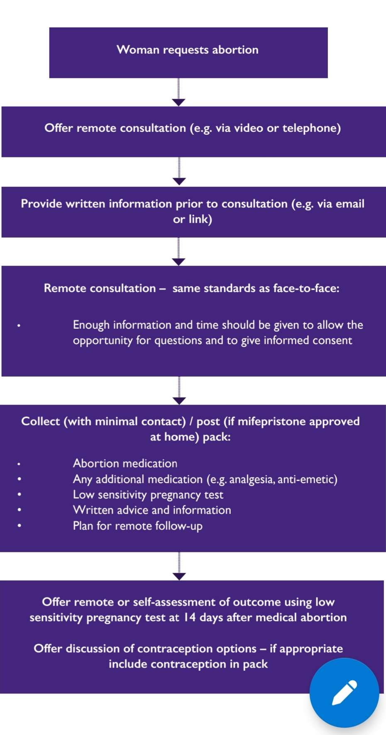
Introducing a courier delivery service for Early Medical Abortions at University Hospital Wales
P Vansia (ST2 Community Sexual and Reproductive Health)
Acute Gynaecology Admissions
Of the 10% admitted, 1 patient was admitted for hyperemesis after mifepristone and the other 6 were admitted for heavy bleeding. Almost all of those with heavy bleeding were managed conservatively with one of or combination of IV fluids, antibiotics and removal of products from cervical os with speculum and forceps. One patient underwent a category 1 evacuation of retained products of conception (ERPC) and required a blood transfusion. This patient had been previously followed up in PAS clinic for her symptoms and opted for medical rather than surgical management of her bleeding. Only this patient who required surgery and a blood transfusion was admitted for over 24 hours.
One fifth of those having an EMA were eligible for or opted for home delivery of medications, showing that a good proportion of patients can be treated remotely to help reduce the transmission of coronavirus. The 10% of logistical errors with the courier delivery did not lead to any adverse events and signified teething problems in a new service that were later ironed out by liaising with the various departments involved. The most common reason for further follow-up or unplanned hospital admission was heavy bleeding and retained products of conception (RPOC). The admission rate to hospital was higher than expected from the literature (Endler et al, 2019). It difficult to ascertain whether or not these were related to the courier delivery e.g. inaccurate dates from last menstrual period, poor counselling via telemedicine, incorrectly taken medication etc. Reassuringly only 1 needed a surgical procedure and blood transfusion, giving an adverse event rate at around 1.5%. This suggests more thorough counselling about what to expect from the procedure and ensuring easy access to ongoing advice for patients could help prevent these admissions for heavy bleeding. One patient had a possible failing ectopic but did not require any intervention, again highlighting the importance of counselling patients about the possible need for further follow-up and adverse outcomes. Most importantly, over 80% of patients undergoing EMA via home delivery had an unremarkable procedure and required no further follow-up, suggesting it is a safe and effective way of providing EMAs whilst reducing unnecessary COVID-19 exposure risk to both patients and staff.
INTRODUCTION AND METHOD
RESULTS
The advent of the COVID-19 pandemic led to widespread changes in abortion care across the United Kingdom, supported by guidance from the Royal College of Obstretrics and Gynaecology (RCOG, 2020) as summarised in the flowchart below.
A total of 431 new patients attended the PAS clinic between June-August 2020. 339 (79%) of these had EMA and of these 68 (20%) had medications delivered to their home. 7 of the patients did not have their deliveries when planned; 1 was due to the patient not being in the house and the other 6 due to courier service issues.
Follow-up clinic appointments
DISCUSSION
For the University of Hospital Wales (UHW) Pregnancy Advisory Service (PAS) these changes were hugely different to prior practice. Although the benefits of reducing coronavirus exposure and spread by eliminating the need to come into a hospital or clinic setting was clear, the safety and effectiveness of delivering mifepristone and misoprostol to patients for early medical abortions (EMA) without having seen a healthcare professional face-to-face remained uncertain. We followed up all patients who had an EMA courier delivery in the first 3 months of the service being introduced (June-August 2020).
Reason | Outcome
1. Heavy bleeding | Scan showed empty cavity
2. ?not passed products, language barrier | Clarified products passed with interpreter, scan showed empty cavity
3. Minimal PV loss after misoprostol | Possible ovarian mass on scan, serial bhcgs dropped
4. Positive pregnancy test 3 weeks after EMA | Scan showed RPOC. Opted for MVA
5. Heavy bleeding | RPOC on scan, opted for more misoprostol and repeat scan, admitted to hospital in between for emergency ERPC and blood transfusion
REFERENCES
Patients were called 3-7 days after their planned delivery to identify any logistical problems with the service. We then reviewed the UHW IT system to see if patients were seen again in PAS or admitted to hospital in the 6 weeks following their procedure.
Endler, M., Lavelanet, A., Cleeve, A., Ganatra, B., Gomperts, R. and Gemzell‐Danielsson, K. (2019). Telemedicine for medical abortion: a systematic review. BJOG: An International Journal of Obstetrics & Gynaecology, 126(9), pp.1094–1102.
Royal College of Obstetricians & Gynaecologists. (n.d.). Coronavirus (COVID-19) infection and abortion care. [online] Available at: https://www.rcog.org.uk/en/guidelines-research-services/guidelines/coronavirus-abortion/ [Accessed 24 Sep. 2020].

