Slide 1

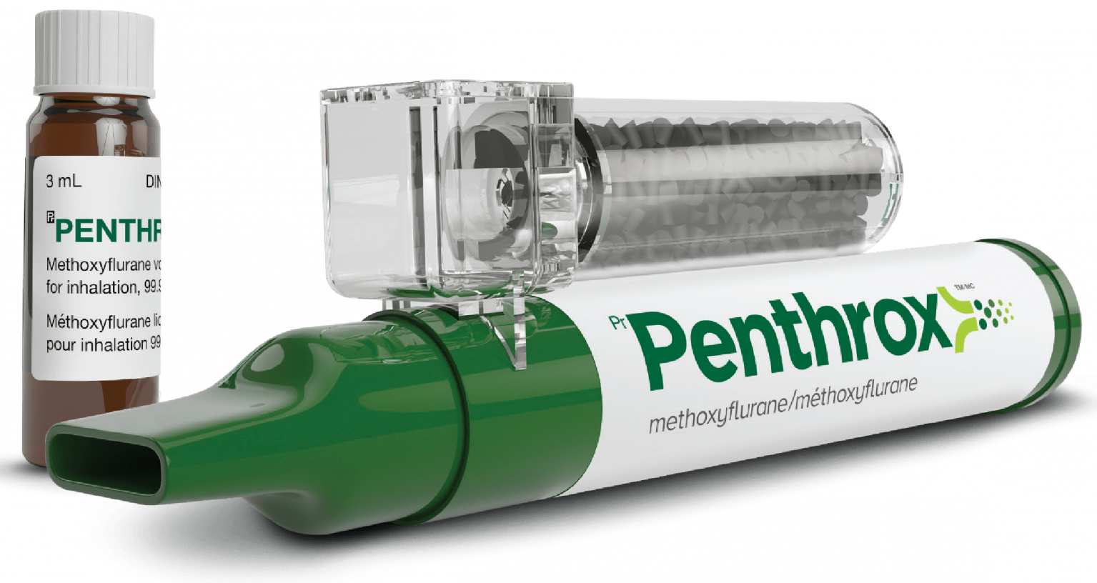
Experience of novel inhalation agent Penthrox for MVA during COVID-19 Ideal agent for analgesia and anxiolysis?
Authors: Forster LS, Lord JM, Royal Cornwall Hospitals NHS Trust

Slide 2
What is Penthrox?
Penthrox (methoxyflurane) is an inhaled vapour
It has an excellent safety record and is widely used in pre-hospital care
It is delivered by a single use inhaler costing ~£18
Analgesia is rapid and should occur within 6-10 inhalations
It is a more powerful analgesic than Entonox and additionally has an anxiolytic action
It is therefore ideally suited to ambulatory gynaecology procedures but there is very little evidence of its use in gynaecology

Slide 3
Introduction
During the COVID-19 pandemic, manual vacuum aspiration (MVA) using a paracervical local anaesthetic block became the routine surgical solution for abortion care owing to difficulties in accessing theatres
A different cohort required ambulatory procedures and urgent changes were required to manage their potential distress
Penthrox was offered from 26/3/20 using Chair’s action through the medical director’s office while Trust governance committees were suspended
Since then approval has been formally granted through the normal governance routes

Slide 4
Methods
In this cohort analysis all women undergoing MVA were invited to complete a service evaluation questionnaire immediately after the procedure
All 22 patients receiving Penthrox in the evaluation period were included
“No Penthrox” data is from women who had an MVA prior to the introduction of Penthrox when Entonox was offered
Data from the two cohorts was collated separately

Slide 5
Results | Penthrox (+ paracervical block) | No Penthrox (+ paracervical block +/- Entonox)
Number | 22 | 337
Mean pain score Severe pain (≥8/10) Minimal pain (≤2/10) | 3.1 0% 36% | 4.4 11% 22%
Mean pain score from normal menstruation Severe pain from menstruation (≥8/10) | 4.6 9% | 4.4 7%
Care rated as excellent | 96% | 96%
“Did you find the whole process better or worse than expected?” Better/much better Much better | 86% 71% | 69% 43%

Slide 6
Conclusions
Penthrox is effective in reducing pain in women having an
abortion under local anaesthesia:
Lower mean pain score
Lower rate of severe pain
Pain reported to be less than normal menstruation
More patients reporting experience “better than expected” even though many in this group would have previously opted for a general anaesthetic

