Slide 1


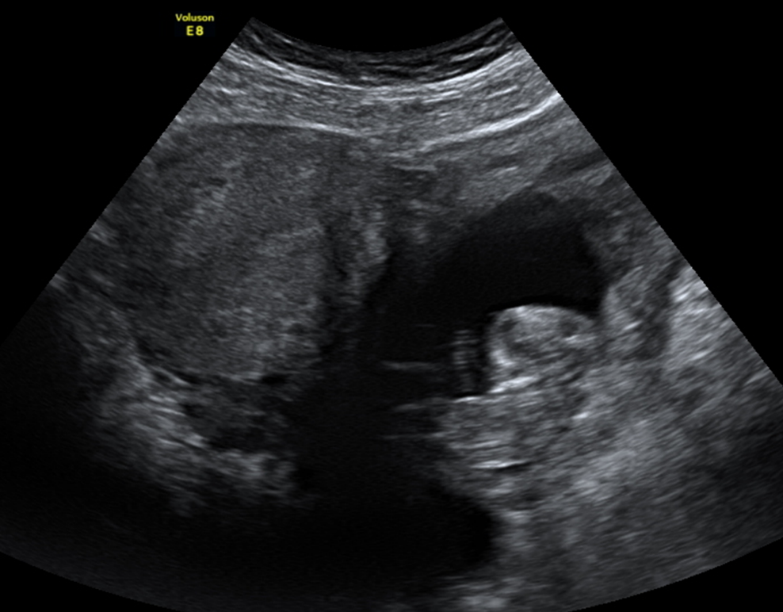
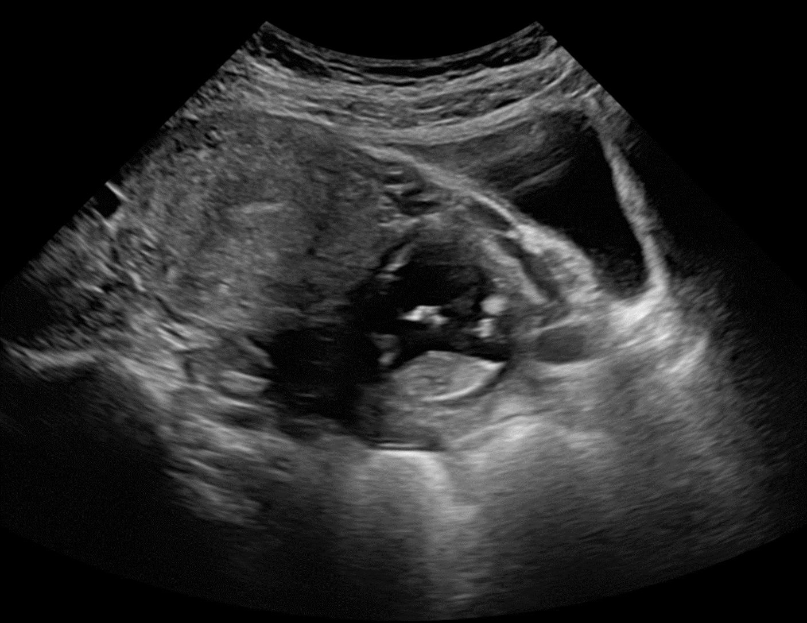
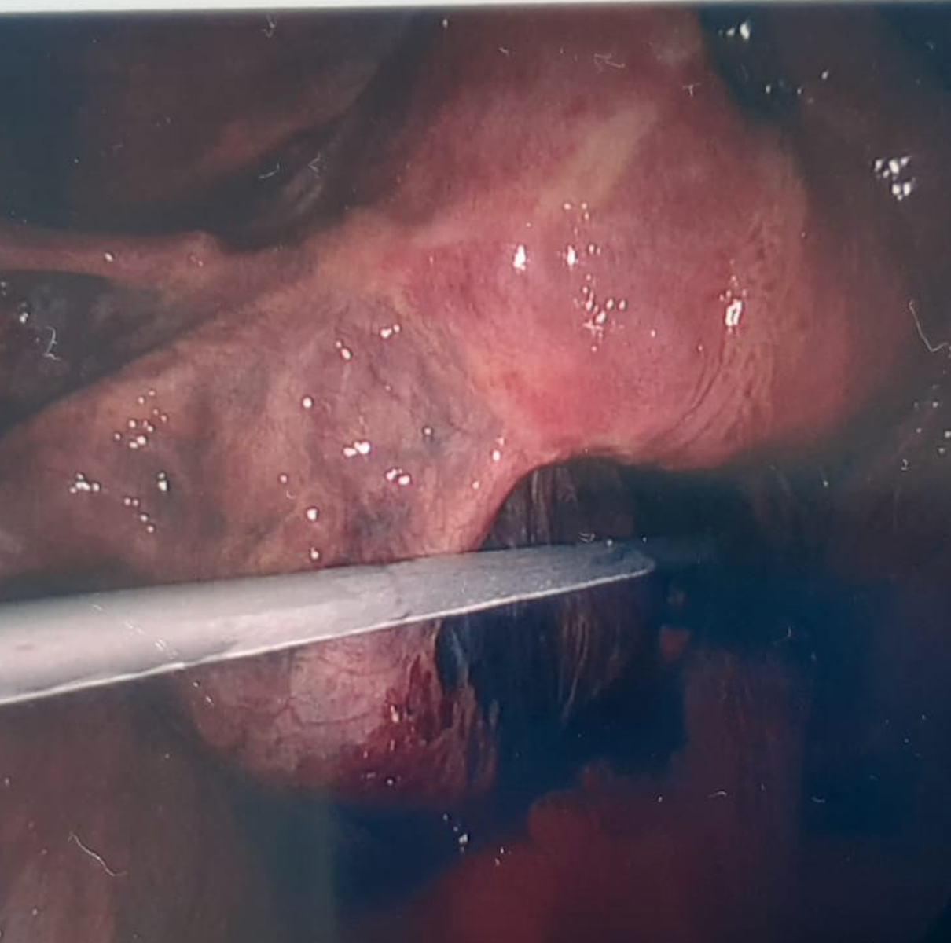
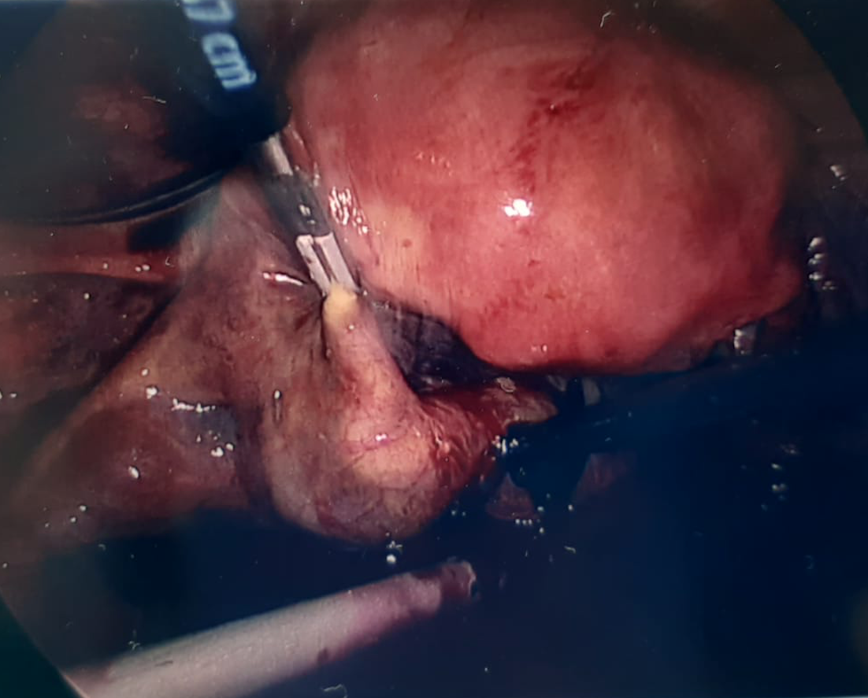
A Rare Coincidence: A second trimester ectopic pregnancy following early medical abortion
CM McCarthy, D Hayes-Ryan, V O’Dwyer
Rotunda Hospital, Parnell Square, Dublin 1
Background
Discussion
Early medical abortion (EMA) was introduced in the Republic of Ireland on 1st January 2019.¹ The majority of EMA is carried out in primary care under 10 weeks’ gestation. As per national clinical guidelines, an ultrasound is not mandatory prior to EMA provided no risk factors or clinical concerns for ectopic pregnancy are present.¹ If an ultrasound is required, a referral pathway from the community exists. Ectopic pregnancy following EMA is rare (approx. 7/100,000).² Ectopic pregnancy continuing into the second trimester is even rarer and can be associated with significant morbidity and mortality.³
We discuss the unprecedented presentation of an unruptured second trimester tubal ectopic pregnancy following an unsuccessful EMA.
Issues which this case highlights:
While ultrasound is not a pre-requisite, it should have been considered in this case due to multiple risk factors including an irregular menstrual cycle and recent surgical history.
EMA was inadvertently administered at 11 weeks’ gestation, and thus a lower dose of medication was administered resulting in a higher likelihood of failure.
The recent bariatric surgery may also have limited the absorption of the medical protocol utilised.
Given this pregnancy was in the second trimester, it was difficult to delineate the origin of the pregnancy, demonstrating the importance of a consistent, systematic approach to ultrasound
Case presentation
A 35 year old woman was referred from primary 17 days following EMA with a positive pregnancy test. She had three previous vaginal deliveries and a seven week spontaneous miscarriage in the preceding year. She had recently undergone a sleeve gastrectomy, after which her menstrual cycle was noted to be erratic. The contraceptive patch was being used for contraception.
At presentation for EMA in primary care, she was noted to be 6+3 weeks gestation based on her last menstrual period, and had a heavy bleed following mifepristone/misoprostol administration.
Upon review in secondary care, an ultrasound demonstrated an ongoing pregnancy that was extra-uterine and measuring 14 weeks by biparietal diameter (See Image ½). Given the advanced gestation, the exact location of the pregnancy was difficult to establish but it appeared to be situated in the Pouch of Douglas, in close approximation to the rectum and iliac vessels.
A multi-disciplinary team was convened and a decision was made for diagnostic laparoscopy, with consent to proceed to laparotomy, unilateral salpingo-oophorectomy and/or hysterectomy given the uncertain location of pregnancy location and vasculature.
A surgical team with complex laparoscopic surgical expertise was assembled, and during a four-port laparoscopy, a large left ectopic pregnancy was detected in the left fallopian tube, resting on the floor of the Pouch of Douglas (Figure 3 and 4). Significant haematoperitoneum was detected during initial pelvic exploration, and the operation proceeded with a left salpingectomy, with a blood loss of 600ml. One unit of red cells were administered post-operatively and a full recovery was made by the patient.
Figures 1 and 2 : Transabdominal ultrasound images of ectopic pregnancy.
Figures 3 and 4: Intraoperative images prior to salpingectomy.
Treatment
References:
¹ Termination of pregnancy under 12 weeks. Institute of Obstetricians and Gynaecologists, Royal College of Physicians, Version 1.0, Published December 2018.
² Department of Health: Regulation of Termination of Pregnancy Act 2018
³ Cleland K., Creinin M.D., Nucatola D., Nshom M. & Trussell J. Significant adverse events and outcomes after medical abortion. Obstet Gynecol 2013; 121 (1): 166-171
⁴ Knight M, Bunch K, Tuffnell D, Shakespeare J, Kotnis R, Kenyon S, Kurinczuk JJ (Eds.) on behalf of MBRRACE-UK. Saving Lives, Improving Mothers’ Care - Lessons learned to inform maternity care from the UK and Ireland Confidential Enquiries into Maternal Deaths and Morbidity 2015-17. Oxford: National Perinatal Epidemiology Unit, University of Oxford 2019.

