Slide 1

Digital transformation in response to the Covid-19 pandemic

Slide 2

Like all organisations, coronavirus and the subsequent national lockdown have led to huge changes for Marie Stopes UK.
It has been a catalyst for digital innovation and has demonstrated the importance of transforming the way we use technology.
We were determined to keep the impact to our services minimal and acted quickly to implement alternative ways for clients to receive support, by introducing a live webchat and video consultations for telemedicine.
Notes:
Discussion points > range of options> not a full-scale proposal.
Set the scene> Help to build the business case

Slide 3


Supporting clients through Covid-19
Video consultations:
Since July 2020, Marie Stopes UK has also been offering clients the option of having a video consultation via Microsoft Teams. This service is particularly important to clients who cannot, or do not want to attend a clinic for a variety of reasons from lockdown restrictions or childcare commitments to mobility or travel limitations.
In June 2020, Marie Stopes UK launched a live webchat tool enabling clients to ask contact centre staff questions without the risk of being overheard. This service has been particularly useful for young people living at home with their parents, women in domestic violence environments and people who do not speak English as their first language, allowing them to independently use programmes like Google Translate to chat with an adviser.
Webchat:

Slide 4
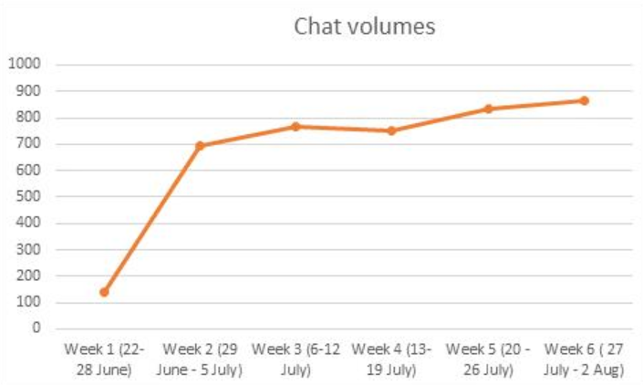

Webchat
Key results:
11,157 unique chats since launch (20 Jun to 22 Sep)
On average clients rated chat 4.8/5 stars
Webchat enables us to generate reports and FAQs from the viewed chat content i.e. 0.6% of chats were safeguarding, 12.8% post treatment, 0.9% overseas, and 0.2% GP

Slide 5
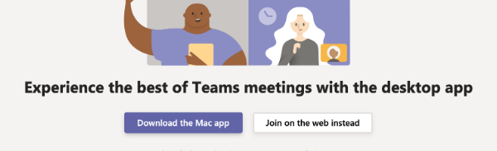
Key results:
Video consultations
Clients rated video 4.75/5 stars
97% say video offers a more personal service than telephone, and 93% would choose video again over a face-to-face visit or phone call
53% video consultations were completed without difficulty (majority of others were completed via telephone as an alternative)
19% of video consultations were converted to telephone
9% clients did not proceed due to technical difficulties

Slide 6

Conclusion
Webchat offers a vital communication channel regardless of the Covid-19 pandemic, which is demonstrated by the volume of chats received
Webchat is reaching clients earlier in their journey, with many clients contacted Marie Stopes UK prior to taking a pregnancy test or with general queries making discussions about sexual health more accessible
Webchat offers a lifeline for people with safeguarding concerns as we can provide discreet advice and support
Video consultations are essential for clients who cannot or do not want to travel to a clinic but want to see a medical professional
Although video uptake is not exceptionally high, for the clients that have used it they have benefitted from it and would use it again
Video consultations present the possibility of client technical challenges which cannot be controlled. Although measures have been implemented to make guidance around video consultations clearer, a back-up telephone line to continue the appointment must be available
Continuing digital transformation will provide more choice for clients, enhance the quality of the service and allow clients to take ownership of their care

