Slide 1
Contraception
Michael Nevill
Director of Nursing, BPAS
NICE Guideline Committee Member

Slide 2
The views expressed in this presentation are those of the authors and not necessarily those of NICE
Guideline is available from: https://www.nice.org.uk/guidance/NG140

Slide 3
1. What strategies are effective at facilitating access to contraception after abortion?

Slide 4
Summary of Protocol
Population | ToP services in OECD countries
Intervention | ToP provider has necessary knowledge and skills to provide contraception Immediate provision of contraception by ToP provider Full range of contraception options are available ToP provider has funding to provide contraception
Comparison | ToP provider has necessary knowledge and skills to provide contraception vs ToP provider not skilled in contraception provision Contraception provided by ToP provider at the time of the termination or when the termination is determined to be complete vs contraception provided by ToP provider at a later date Contraception provided by ToP provider at the time of the termination or when the termination is determined to be complete vs contraception provided by non-ToP provider at a later date Full range of contraceptive methods is available vs subset of contraceptive methods is available ToP provider has funding to provide contraception vs ToP provider has no specific funding for contraception
Critical Outcomes | Receipt of chosen method of contraception Subsequent termination of pregnancy within 12 months Continuation of contraception within 12 months
Important Outcomes | Patient satisfaction Number who receive LARC rather than any contraception Proportion who received contraception

Slide 5
Research results

Slide 6
Summary: ToP provider has necessary knowledge and skills to provide contraception vs ToP provider not skilled in contraception provision
Outcome | Favours
Number who receive LARC rather than any contraception: RCT evidence | No difference
Number who receive LARC rather than any contraception: Non-RCT evidence | Favours skilled providers
Proportion who received contraception (non-RCT) | No difference

Slide 7
Summary: Contraception provided by ToP provider at the time of the termination or when the termination is determined to be complete vs contraception provided by ToP provider at a later date
Outcome | Favours
Receipt of chosen method of contraception – IUD after mToP: RCT evidence | No difference
Receipt of chosen method of contraception – IUD after sToP: RCT evidence | Favours immediate
Receipt of chosen method of contraception – IUD after sToP: Non-RCT evidence | Favours immediate
Receipt of chosen method of contraception – implant after mToP: RCT evidence | Unclear due to heterogeneity
Receipt of chosen method of contraception – implant after mToP: Non-RCT evidence | Favours immediate
Receipt of chosen method of contraception – implant after sToP: RCT evidence | Favours immediate
Receipt of chosen method of contraception – DMPA after mToP: RCT evidence | No difference

Slide 8
Summary: Contraception provided by ToP provider at the time of the termination or when the termination is determined to be complete vs contraception provided by ToP provider at a later date
Outcome | Favours
Subsequent termination of pregnancy within 12 months (RCT) | Favours immediate
Continuation of contraception within 12 months – after mToP (RCT) | No difference
Continuation of contraception within 12 months – after sToP: RCT evidence | 3/4 studies favour immediate
Continuation of contraception within 12 months – after sToP: Non-RCT evidence | Favours immediate

Slide 9
Summary: Contraception provided by ToP provider at the time of the termination or when the termination is determined to be complete vs contraception provided by ToP provider at a later date
Outcome | Favours
Patient satisfaction – preferred allocated time of insertion (RCT) | Favours immediate
Patient satisfaction – with group assignment at enrolment | Favours immediate
Patient satisfaction – with group after termination complete | Favours immediate
Patient satisfaction – with implant at 6 months follow-up | No difference
Number who receive LARC rather than any contraception (RCT) | No difference
Proportion who received contraception | NO EVIDENCE

Slide 10
Summary: Full range of contraceptive methods is available versus subset of contraceptive methods is available
Outcome | Favours
Receipt of chosen method of contraception (IUD; non-RCT) | Favours LARC available
Subsequent termination of pregnancy within 12 months (non-RCT) | Favours LARC available
Continuation of contraception within 12 months | NO EVIDENCE
Patient satisfaction | NO EVIDENCE
Number who receive LARC rather than any contraception (non-RCT) | Favours LARC available
Proportion who received contraception (non-RCT) | Favours LARC available

Slide 11
Making recommendations
Evidence showed contraception provision immediately after abortion increased uptake and reduced subsequent abortions.
Higher rates of patient satisfaction when contraception was provided immediately.

Slide 12
Recommendations
Commissioners and providers should ensure that the full range of reversible contraceptive options…is available for women on the same day as their surgical or medical abortion
Providers should ensure staff have the knowledge and skills to provide all contraceptive options

Slide 13
2. For women who have had a medical abortion, how soon afterwards is it safe to insert an intrauterine contraceptive device?

Slide 14
Search strategy (1)
Population | Women who are having medical termination of pregnancy and who have requested an intrauterine contraceptive device: - Levonorgestrel-releasing intrauterine system (LNG-IUS) - Copper intrauterine contraceptive device
Intervention | - Immediate insertion on day of termination of pregnancy - Early insertion (<7 days since expulsion, but not inclusive of immediate expulsion) - Delayed insertion (>7 days since expulsion)
Comparison | Comparisons of any of the below timings of the insertion of an intrauterine contraceptive device: -Immediate insertion on day of termination of pregnancy - Early insertion (<7 days since expulsion, but not inclusive of immediate expulsion) - Delayed insertion (>7 days since expulsions

Slide 15
Search strategy (2)
Critical Outcomes | Expulsion of IUD Continuation of IUD Uterine perforation
Important Outcomes | Uptake rate of IUD Patient acceptability / satisfaction Infection within first month of the IUD insertion Subsequent pregnancy within 1 year of the IUD insertion

Slide 16
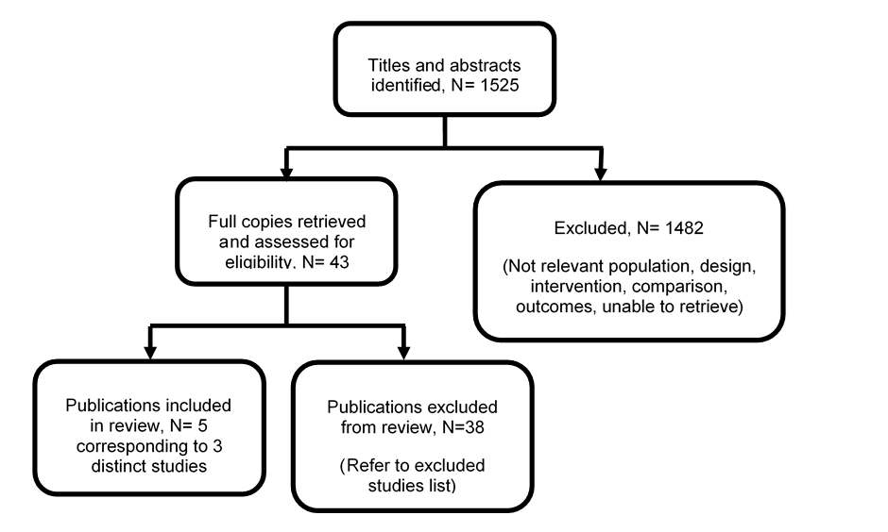
PRISMA Study Flow Diagram

Slide 17
Summary: Early/immediate vs. delayed insertion
Outcome | Early/immediate versus delayed
IUD expulsion | ≤ 9 weeks⁺⁰ LNG-IUS: No difference
 | ≤ 9 weeks⁺⁰ Cu-IUD: No difference
 | 9 weeks⁺¹ to ≤ 12 weeks⁺⁰ LNG-IUS: Favours delayed
 | 12 weeks⁺¹ to ≤ 20 weeks⁺⁰ LNG-IUS: No difference
Continuation of IUD use | ≤ 9 weeks⁺⁰ LNG-IUS: No difference
 | ≤ 9 weeks⁺⁰ Cu-IUD: No difference
 | 9 weeks⁺¹ to ≤ 12 weeks⁺⁰ LNG-IUS: Favours immediate
 | 12 weeks⁺¹ to ≤ 20 weeks⁺⁰ LNG-IUS: Favours immediate
Uterine perforations | ≤ 9 weeks⁺⁰ LNG-IUS: No difference
 | ≤ 9 weeks⁺⁰ Cu-IUD: No difference
 | 9 weeks⁺¹ to ≤ 12 weeks⁺⁰ LNG-IUS: No difference
 | 12 weeks⁺¹ to ≤ 20 weeks⁺⁰ LNG-IUS: No difference

Slide 18
Summary: Early/immediate vs. delayed insertion
Outcome | Early/immediate versus delayed
Uptake rate of IUD | ≤ 9 weeks⁺⁰ LNG-IUS: No difference
 | ≤ 9 weeks⁺⁰ Cu-IUD: Favours immediate
 | 9 weeks⁺¹ to ≤ 12 weeks⁺⁰ LNG-IUS: No difference
 | 12 weeks⁺¹ to ≤ 20 weeks⁺⁰ LNG-IUS: No difference
Infections within 1 month of insertion | ≤ 9 weeks⁺⁰ LNG-IUS: No difference
 | ≤ 9 weeks⁺⁰ Cu-IUD: No difference
 | 9 weeks⁺¹ to ≤ 12 weeks⁺⁰ LNG-IUS: No difference
 | 12 weeks⁺¹ to ≤ 20 weeks⁺⁰ LNG-IUS: No difference
Subsequent pregnancy within 1 year | ≤ 9 weeks⁺⁰ LNG-IUS: No difference
 | ≤ 9 weeks⁺⁰ Cu-IUD: No difference
 | 9 weeks⁺¹ to ≤ 12 weeks⁺⁰ LNG-IUS: No difference
 | 12 weeks⁺¹ to ≤ 20 weeks⁺⁰ LNG-IUS: No difference

Slide 19
Results
Evidence showed that compared with delayed insertion, early or immediate insertion of an IUD provided either higher rates or no clinically important difference in uptake and continued use.
Evidence was unclear in differences in rates of:
Uterine perforation
Infection within 1 month
Subsequent unintended pregnancy within 1 year

Slide 20
Recommendations
Women who choose intrauterine methods of contraception are offered this:
At the same time as surgical abortion
As soon as possible after expulsion of the pregnancy (for medical abortions)

Slide 21
3. For women who are having medical abortion and plan to use a progestogen-only contraceptive implant or depo injection, does administration of the contraception at the same time as mifepristone influence the efficacy of the termination?

Slide 22
Results
Immediate implant or Depo provides an improvement in client satisfaction
Immediate implant insertion provides a clinically important reduction in the rates of subsequent unintended pregnancy
Evidence was unclear in differences in rates of:
Incomplete abortion
Complete abortion
Subsequent unintended pregnancy

Slide 23
Recommendations
Depo
Consider providing it at the same appointment when they take the mifepristone
Explain that having the depo injection at this stage may increase the risk of ongoing pregnancy although the risk is low
Implant
Offer it the day they take mifepristone

Slide 24
Thank you
With thanks to Mia Schmidt-Hansen MSchmidtHansen@rcog.org.uk and Laura O’Shea LOShea@rcog.org.uk

