Slide 1


Best of the Rest Patricia A. Lohr Medical Director, British Pregnancy Advisory Service Treasurer, British Society of Abortion Care Providers NICE Guideline Committee Member

Slide 2
The views expressed in this presentation are those of the authors and not necessarily those of NICE Guideline is available from: https://www.nice.org.uk/guidance/NG140

Slide 3
Anaesthesia or sedation for surgical termination of pregnancy? Laura O’Shea

Slide 4
Summary of Protocol (1)
Population | Women who are having a uterine evacuation for surgical termination of pregnancy using electric or manual vacuum aspiration, or dilatation and evacuation.
Intervention | Local anaesthesia: Paracervical block Intracervical block Intrauterine installation Anaesthetic gel (e.g., lidocaine) Conscious sedation: Oral or IV Benzodiazepines Zopiclone Nitrous oxide and oxygen mixture (Entonox or titrated nitrate) Deep sedation: IV Benzodiazepines Propofol Ketamine General anaesthesia: IV Benzodiazepines Propofol Sevoflurane Isoflurane Desflurane Ketamine Thiopentone Etomodate

Slide 5
Summary of Protocol (2)
Comparison | Local vs. conscious sedation Local vs. deep sedation Local vs. general anaesthesia Conscious sedation vs. deep sedation Conscious sedation vs. general anaesthesia Deep sedation vs. general anaesthesia Propofol (general) vs. sevo/ iso/ desflurane (general) Oral vs. IV conscious sedation Local anaesthesia method A vs. local anaesthesia method B
Critical Outcomes | Patient satisfaction Termination of pregnancy completed with intended method of sedation/anaesthesia Pain
Important Outcomes | Haemorrhage requiring transfusion or >500ml of blood loss Nausea Vomiting Length of admission

Slide 6

PRISMA Study Flow Diagram

Slide 7
Local anaesthesia vs. conscious sedation
Outcome | Favours
Satisfaction: would recommend to friend | Conscious sedation
Satisfaction: overall satisfaction: excellent | Conscious sedation
Satisfaction: overall satisfaction: fair | Conscious sedation
Satisfaction: anxiety control (100mm VAS) | Conscious sedation
Satisfaction: overall satisfaction: satisfactory | No difference
Satisfaction: overall satisfaction: unsatisfactory | No difference
Satisfaction: overall satisfaction: overall | No difference
Satisfaction: pain control (100mm VAS) | No difference
Pain during aspiration | No difference
Vomiting | No difference
Haemorrhage; length of admission | No evidence

Slide 8
Deep sedation vs. general anaesthesia
Outcome | Favours
Pain during hospital stay (11-point scale) | Deep sedation
Satisfaction: would have same again | No difference
Pain during travel home | No difference
Pain during | No difference
Termination completed; haemorrhage; nausea; vomiting; length of admission | No evidence

Slide 9
Propofol vs. sevoflurane (general)
Outcome | Favours
Satisfaction: overall satisfaction | No difference
Satisfaction: would recommend to friend | No difference
Termination completed | No difference
Pain during recovery AND 24 hours post-op | No difference
Pain upon waking from anaesthesia (10cm VAS) | No difference
Pain upon discharge (10 cm VAS) | No difference
Haemorrhage (Note. One trial stopped early due to higher blood loss in sevoflurane arm) | No difference
Nausea | No difference
Vomiting | No difference
Length of admission | No evidence

Slide 10
Oral vs. IV conscious sedation
Outcome | Favours
Satisfaction: pain control: completely/mostly acceptable | IV
Satisfaction: pain control: somewhat acceptable | IV
Satisfaction: would choose same method again: definitely/probably | IV
Satisfaction: would choose same method again: probably/ definitely not | IV
Intraoperative pain: (100-point scale) | IV
Intraoperative pain: mild | IV
Intraoperative pain: severe | IV
Nausea | IV
Satisfaction: pain control: mostly/completely unacceptable OR would recommend to friend OR would choose same method again: don’t know; intraoperative pain: moderate; postoperative pain (100-point scale); vomiting | No difference
Termination completed; haemorrhage; nausea; length admission | No evidence

Slide 11
Local method A vs. method B
Outcome | Favours
Paracervical block vs. intracervical block
Pain with cervical dilation (10cm VAS); pain with aspiration/curettage (10cm VAS); nausea; vomiting | No difference
Satisfaction; termination completed; haemorrhage; length of admission | No evidence
Paracervical block vs. lidocaine gel
Satisfaction: overall satisfaction (100mm VAS); satisfaction: would recommend to friend (100mm VAS); pain with cervical dilation (100mm VAS); pain 30-45 minutes postoperation (100mm VAS) | No difference
Termination completed; haemorrhage; nausea; vomiting; length of admission | No evidence
Paracervical block + intrauterine infusion vs. paracervical block
Pain with aspiration/curettage Satisfaction: overall satisfaction (100mm VAS); pain with cervical dilation (100mm VAS); pain 30-45 minutes postoperation (100mm VAS) | Unclear/No difference
Termination completed; haemorrhage; vomiting; length of admission | No evidence

Slide 12
Recommendations
1.31.1 For women having surgical abortion, consider local anaesthesia alone, conscious sedation with local anaesthesia, deep sedation or general anaesthesia. To help women make an informed choice, discuss the options with them and explain that:
Having local anaesthesia alone means they will spend less time in hospital
Intravenous sedation plus local anaesthesia will help if they are anxious about the procedure
With deep sedation or general anaesthesia they will usually not be aware of the procedure

Slide 13
Recommendations (con’t)
1.13.2 When using conscious sedation for a surgical abortion, use intravenous rather than oral sedation
1.13.3 When using general anaesthesia for a surgical abortion, consider intravenous propofol and a short-acting opioid (such as fentanyl) rather than inhalational anaesthesia

Slide 14
Rationale
With limited evidence
Acknowledged could not recommend “optimal”
Recognised importance of preferences
Made research recommendations
Local anaesthesia
Inhalational anaesthetics and blood loss

Slide 15
VTE prophylaxis for termination of pregnancy up to 24 weeks’ gestation Mia Schmidt-Hansen

Slide 16
Summary of Protocol (1)
Population | Women who are having a surgical or medical termination of pregnancy up to 24 weeks gestation and have been identified as requiring pharmacological thromboprophylaxis
Intervention | Low molecular weight heparin Direct oral anti coagulants
Comparison | Any comparisons of 1-4 will be included: Low molecular weight heparin started at time A for duration A Low molecular weight heparin started at time A for duration B Low molecular weight heparin started at time B for duration A Low molecular weight heparin started at time B for duration B Low molecular weight heparin (any start time and duration) vs. direct oral anti coagulants (any start time and duration)

Slide 17
Summary of Protocol (2)
Critical Outcomes | Cardiovascular mortality within 6 weeks of termination Major bleeding for the duration of low molecular weight heparin (as defined by the International Society on Thrombosis and Haemostasis bleeding scale) Fatal pulmonary embolism within 6 weeks of termination
Important Outcomes | Symptomatic deep vein thrombosis within 6 weeks of termination Pulmonary embolism within 6 weeks of termination Clinically relevant minor bleeding for the duration of low molecular weight heparin (as defined by the International Society on Thrombosis and Haemostasis bleeding scale) Patient satisfaction

Slide 18
PRISMA Study Flow Diagram
Titles and abstracts identified, N= 1451
Full copies retrieved and assessed for eligibility, N=2
Excluded, N= 1449
Studies included in review, N=0
Publications excluded from review, N=2

Slide 19
Recommendations
1.5.1 For women who need pharmacological thromboprophylaxis, consider low-molecular-weight heparin for at least 7 days after the abortion
For women who are at high risk of thrombosis, consider starting low-molecular-weight heparin before the abortion and giving it for longer afterwards

Slide 20
Rationale
In the absence of evidence
Recommendations based on NICE guidance on VTE risk reduction for women who have had a termination within 6 weeks of surgery
“High risk” based on knowledge and experience and existing RCOG antenatal and post-natal risk assessments

Slide 21
NICE on VTE risk reduction in pregnancy
1.1.9 Assess all women on admission to hospital or a midwife-led unit if they are pregnant or gave birth, had a miscarriage or had a termination of pregnancy in the past 6 weeks, to identify their risk of VTE and bleeding. Use a tool published by a national UK body, professional network or peer-reviewed journal.
Most commonly used risk assessment tool was developed by the Royal College of Obstetricians and Gynaecologists.
Venous thromboembolism in over 16s: reducing the risk of hospital-acquired deep vein thrombosis or pulmonary embolism . NICE guideline [NG89] Published date: March 2018 Last updated: August 2019

Slide 22
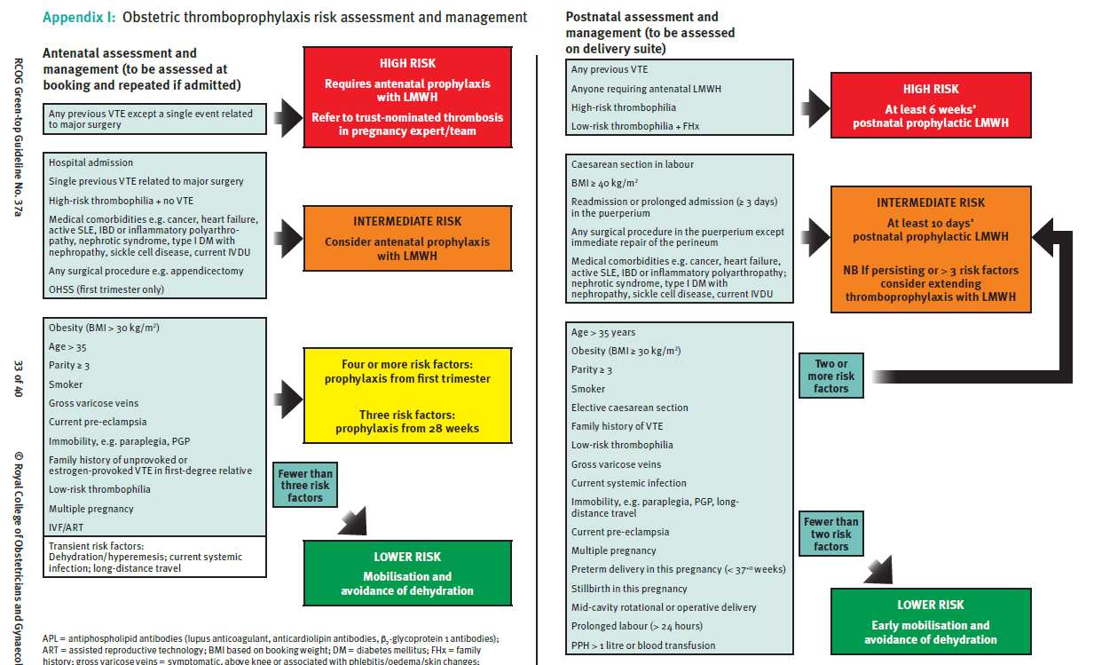
RCOG risk assessment tool
Thrombosis and Embolism during Pregnancy and the Puerperium, Reducing the Risk (Green-top Guideline No. 37a)

Slide 23
NICE on VTE risk reduction in pregnancy
1.16.1 Consider LMWH for all women who are admitted to hospital or a midwife-led unit if…had a termination of pregnancy in the past 6 weeks, and whose risk of VTE outweighs their risk of bleeding.
1.16.5 If using LMWH… start 4–8 hours after the event unless contraindicated and continue for a minimum of 7 days.
1.16.6 Consider combined prophylaxis with LMWH plus mechanical prophylaxis for…termination of pregnancy in the past 6 weeks and who are likely to be immobilised, or have significantly reduced mobility relative to their normal or anticipated mobility for 3 or more days after surgery, including caesarean section
Venous thromboembolism in over 16s: reducing the risk of hospital-acquired deep vein thrombosis or pulmonary embolism . NICE guideline [NG89] Published date: March 2018 Last updated: August 2019

Slide 24
Medical termination of pregnancy after 24 weeks’ gestation Mia Schmidt-Hansen

Slide 25
Summary of Protocol (1)
Population | Women who are having a medical termination of pregnancy after 24⁺⁰ weeks gestation and received both mifepristone and misoprostol Exclusions: Any studies with an indirect population
Intervention | Route of misoprostol administration: vaginal, sublingual, buccal Dose of misoprostol (100, 200, 400, 600, 800 mcg) Dose interval (both interval between mifepristone and misoprostol [simultaneous, delayed] and interval between subsequent doses of misoprostol)
Comparison | All routes of administration, doses, number of doses, and dosing intervals listed above will be compared.

Slide 26
Summary of Protocol (2)
Critical Outcomes | Failure to pass any products of conception Uterine rupture Incomplete abortion with the need for surgical intervention
Important Outcomes | Time to expulsion (induction-to-abortion interval) Diarrhoea Haemorrhage requiring transfusion or ≥500 ml of blood loss Infection reported within 1 month of termination

Slide 27
PRISMA Study Flow Diagram
Titles and abstracts identified, N= 1294
Full copies retrieved and assessed for eligibility, N= 53
Excluded, N= 1241
(Not relevant population, design, intervention, comparison, outcomes, unable to retrieve)
Studies included in review, N= 0
Publications excluded from review, N=53

Slide 28
Recommendations
1.11.1 For women having a medical abortion between 24+0 and 25+0 weeks’ gestation, consider 200 mg oral mifepristone, followed by 400 micrograms misoprostol (vaginal, buccal or sublingual) every 3 hours until delivery.
1.11.2 For women who are having a medical abortion between 25+1 and 28+0 weeks’ gestation, consider 200 mg oral mifepristone, followed by 200 micrograms misoprostol (vaginal, buccal or sublingual) every 4 hours until delivery.

Slide 29
Recommendations (con’t)
1.11.3 For women who are having a medical abortion after 28+0 weeks’ gestation, consider 200 mg oral mifepristone, followed by 100 micrograms misoprostol (vaginal, buccal or sublingual) every 6 hours until delivery
1.11.4 Be aware that:
Uterus more sensitive to misoprostol as gestation advances
Risk factors for uterine rupture include pre-existing uterine scar, increased gestational age, multiparity

Slide 30
Rationale
In the absence of evidence
Used regimens for lower gestations + clinical knowledge/experience
Took into account greater sensitivity of uterus to prostaglandins as gestational age advances
Were aware of FIGO guidance on misoprostol
Made a research recommendation
Feticide out of scope: use existing RCOG guidance

Slide 31
Thank you for your attention.

