Slide 1
Medical abortion regimens: first and second trimester
National Institute for Health and Care Excellence (2019) Abortion Care. Available from https://www.nice.org.uk/guidance/ng140
Joanne Fletcher
Co-chair BSACP
&
Consultant Nurse Gynaecology, STHFT

Slide 2
The views expressed in this presentation are the authors and not necessarily those of NICE.

Slide 3
NICE guideline review questions
For women who are having an early (up to 10⁺⁰ weeks gestation) medical abortion, what is the effectiveness, safety and acceptability of mifepristone and misoprostol given simultaneously compared with other time intervals?
What is the optimal regimen and route of administration of misoprostol after mifepristone, for inducing medical abortion from 10⁺¹ to 24⁺⁰ weeks?

Slide 4
Review question - Up to 10 weeks gestation
For women who are having an early (up to 10⁺⁰ weeks gestation) medical abortion, what is the effectiveness, safety and acceptability of mifepristone and misoprostol given simultaneously compared with other time intervals?

Slide 5
Summary of Protocol
Population | Women who are having a medical abortion up to 10⁺⁰ weeks gestation
Intervention | Simultaneous (within 15 minutes) administration of mifepristone and misoprostol
Comparison | Simultaneous administration vs <8 hour interval Simultaneous administration vs 8-24 hour interval Simultaneous administration vs >8 hour interval
Critical Outcomes | Ongoing pregnancy rate Haemorrhage requiring transfusion or > 500ml of blood loss Patient satisfaction
Important Outcomes | Need for repeat misoprostol Time to onset of cramping or bleeding Total treatment time from mifepristone to expulsion Incomplete abortion with the need for surgical intervention

Slide 6
PRISMA Study Flow Diagram
Titles and abstracts identified, N= 443
Full copies retrieved and assessed for eligibility, N= 23
Excluded, N= 420
(Not relevant population, design, intervention, comparison, outcomes, unable to retrieve)
Studies included in review, N= 3
Publications excluded from review, N=20
(Refer to excluded studies list)

Slide 7
Included Studies
Study and setting | Population | Intervention | Comparison
Creinin 2007 RCT USA | n=1100 Healthy women requesting an elective abortion of an intrauterine pregnancy (with a visible gestational sac) ≤ 63 days of gestation | Simultaneous administration: 200 mg oral mifepristone followed by 800 mcg vaginal misoprostol within 15 minutes | Delayed administration: 200 mg oral mifepristone followed by 800 mcg vaginal misoprostol 23-25 hours later
Goel 2011 RCT India | n=80 Healthy women requesting an elective abortion for a single intrauterine pregnancy ≤49 days of gestation | Simultaneous administration: 200 mg oral mifepristone followed by 400 mcg vaginal misoprostol simultaneously | Delayed administration: 200 mg oral mifepristone followed by 400 mcg vaginal misoprostol 24 hours later.
Verma 2017 RCT India | n=200 Women with an intrauterine pregnancy ≤ 63 days gestation who were willing to comply with the study schedule and to have a surgical abortion if indicated. | Simultaneous administration: 200 mg oral mifepristone followed by 400 mcg vaginal misoprostol | Delayed administration: 200 mg oral mifepristone followed by 400 mcg vaginal misoprostol 48 hours later.

Slide 8
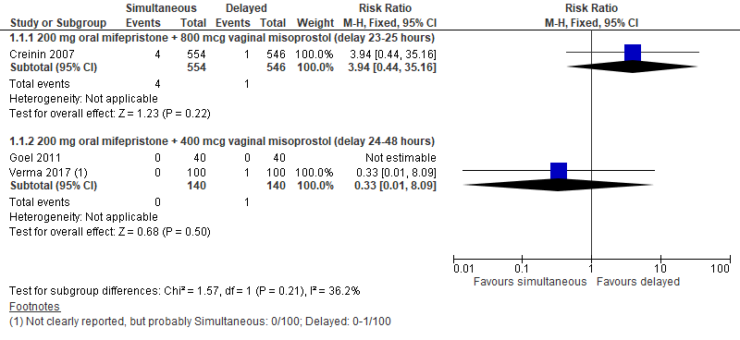
Outcome: Ongoing pregnancy rate
Low quality
Very
low
quality
Notes:
Ongoing pregnancy rate
Low quality evidence from one RCT (n=1100) showed that the ongoing pregnancy rate did not differ clinically significantly between women who received simultaneous oral mifepristone (200 mg) + vaginal misoprostol (800 mcg) administration or administration of misoprostol 23-25 hours after mifepristone (RR = 3.94, 95% CI 0.44-36.16). Very low quality evidence from two RCTs (n=280) showed that the ongoing pregnancy rate did not differ clinically significantly between women who received simultaneous oral mifepristone (200 mg) + vaginal misoprostol (400 mcg) administration or administration of misoprostol 24-48 hours after mifepristone (RR = 0.33, 95% CI 0.01-8.09).

Slide 9
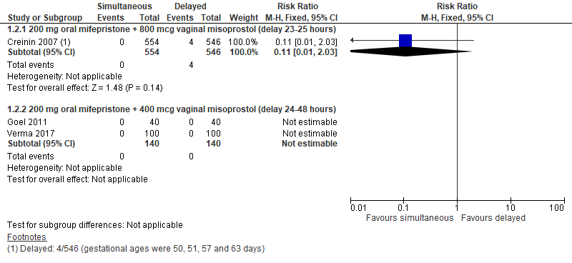
Outcome: Haemorrhage requiring transfusion or 500 ml blood loss or above
Very
low
quality
Very
low
quality
Notes:
Haemorrhage requiring transfusion or ≥ 500 ml blood loss
Very low quality evidence from one RCT (n=1100) showed that the rate of ‘haemorrhage requiring transfusion or ≥ 500 ml blood loss’ did not differ clinically significantly between women who received simultaneous oral mifepristone (200 mg) + vaginal misoprostol (800 mcg) administration or administration of misoprostol 23-25 hours after mifepristone (RR = 0.11, 95% CI 0.01-2.03). Very low quality evidence from two RCTs (n=280) showed that the rate of ‘haemorrhage requiring transfusion or ≥ 500 ml blood loss’ did not differ clinically significantly between women who received simultaneous oral mifepristone (200 mg) + vaginal misoprostol (400 mcg) administration or administration of misoprostol 24-48 hours after mifepristone (no events occurred in either treatment group).

Slide 10
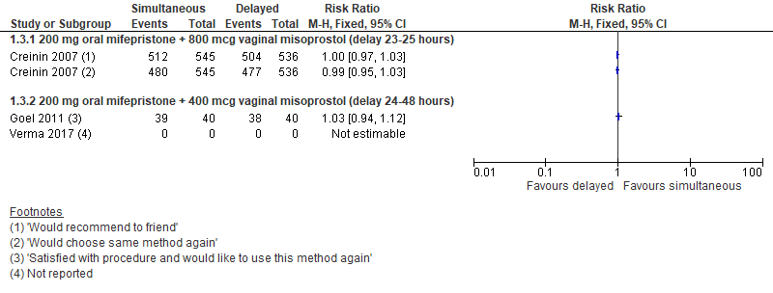
Outcome: Patient satisfaction
Moderate
quality
Low
quality
Notes:
Patient satisfaction
Moderate quality evidence from one RCT (n=1100) showed that patient satisfaction did not differ clinically significantly between women who received simultaneous oral mifepristone (200 mg) + vaginal misoprostol (800 mcg) administration or administration of misoprostol 23-25 hours after mifepristone whether it was measured as “Would choose same method again” (RR = 0.99, 95% CI 0.95-1.03) or “Would recommend to friend” (RR = 1, 95% CI 0.97-1.03). Low quality evidence from one RCT (n=80) showed that patient satisfaction (measured as “Satisfied with procedure and would like to use this method again”) did not differ clinically significantly between women who received simultaneous oral mifepristone (200 mg) + vaginal misoprostol (400 mcg) administration or administration of misoprostol 24 hours after mifepristone (RR = 1.03, 95% CI 0.94-1.12).

Slide 11
Summary
Outcome | Simultaneous versus delayed administration of mifepristone and misoprostol
Ongoing pregnancy rate | No clinically significant difference
Haemorrhage requiring transfusion or > 500ml of blood loss | No clinically significant difference
Patient satisfaction | No clinically significant difference
Need for repeat misoprostol | No clinically significant difference
Time to onset of cramping or bleeding | Same or clinically significantly longer after simultaneous
Total treatment time from mifepristone to expulsion | Clinically significantly shorter for simultaneous
Incomplete abortion with the need for surgical intervention | No clinically significant difference

Slide 12
Other considerations
Committee thought that the findings didn’t necessarily reflect practice
RCTs only included so Lohr et al (2018) retrospective study not included even though n= 28,901 & showed statistically significant difference with success rates of simultaneous regimens inversely proportional to gestation & failure rate 1.5% higher in simultaneous group (2.4% v 09%)
Lohr PA, Starling JE, Scott JG, Aiken ARA. (2018) Simultaneous compared with interval medical abortion regimens where home use is restricted. Obstetrics & Gynaecology, 131, 635-41

Slide 13
Guideline recommendations up to 10 weeks
1.9.1 Offer interval treatment (usually 24 to 48 hours) with mifepristone and misoprostol to women who are having a medical abortion up to and including 10⁺⁰ weeks’ gestation.
1.9.2 For women who are having a medical abortion up to and including 9⁺⁰ weeks’ gestation, give them the choice of having mifepristone and vaginal misoprostol at the same time, but explain that:
the risk of ongoing pregnancy may be higher, and it may increase with gestation
it may take longer for the bleeding and pain to start
it is important for them to complete the same follow-up programme that is recommended for all medical abortions before 10⁺⁰ weeks (see 19 recommendations 1.14.1 and 1.14.2).

Slide 14
What does this mean in practice?
More flexibility for women
More flexibility for services
Can offer same day Mifepristone/ Misoprostol (needs robust follow up) based on gestation
Potentially cheaper for services now home use of Misoprostol available – need to be aware of coding & tariffs!
Dose & route of administration were not reviewed so no new recommendations made

Slide 15
Review question: 10+1 to 23+6 weeks gestation
What is the optimal regimen and route of administration of misoprostol after mifepristone, for inducing medical abortion from 10⁺¹ to 24⁺⁰ weeks?

Slide 16
Summary of Protocol
Population | Women who are having a medical abortion between 10⁺¹ and 24⁺⁰ weeks gestation
Intervention | Route of misoprostol administration: Vaginal / Oral / Sublingual / Buccal Dose of misoprostol: 200 mcg / 400 mcg / 600 mcg / 800 mcg Dose interval
Comparison | All combinations of the routes of administration, doses, number of doses, and dosing intervals
Critical Outcomes | Time to expulsion Complete abortion without the need for surgical intervention Incomplete abortion with the need for surgical intervention
Important Outcomes | Haemorrhage requiring transfusion or > 500 ml of blood loss Vomiting Patient satisfaction Diarrhoea

Slide 17
PRISMA Study Flow Diagram
Titles and abstracts identified, N= 1808
Full copies retrieved and assessed for eligibility, N= 68
Excluded, N= 1740
(Not relevant population, design, intervention, comparison, outcomes, unable to retrieve)
Studies included in review,
N= 11
Publications excluded from review, N=57

Slide 18
Types of misoprostol regimen comparisons
1) Randomized controlled trials comparing misoprostol doses
200 mcg versus 400 mcg
2) Randomized controlled trials comparing misoprostol routes
Vaginal versus oral
Vaginal versus sublingual
Sublingual versus oral
3) Randomized controlled trials comparing mifepristone–misoprostol intervals
Simultaneous versus 1 day
Simultaneous versus 36-38 hours
1 day versus 2 days

Slide 19
11 Studies included
Abbas, D. F., Blum, J., Ngoc, N. T. N., Nga, N. T. B., Chi, H. T. K., Martin, R., Winikoff, B.(2016). Simultaneous Administration Compared with a 24-Hour Mifepristone-Misoprostol Interval in Second-Trimester Abortion, Obstetrics and Gynecology, 128, 1077-1083.
Brouns, J. F. G. M., Van Wely, M., Burger, M. P. M., Van Wijngaarden, W. J. (2010). Comparison of two dose regimens of misoprostol for second-trimester pregnancy termination, Contraception, 82, 266-275.
Chai, J., Tang, O. S., Hong, Q. Q., Chen, Q. F., Cheng, L. N., Ng, E., Ho, P. C..(2009). A randomized trial to compare two dosing intervals of misoprostol following mifepristone administration in second trimester medical abortion, Human Reproduction, 24, 320-324.
Dickinson, J. E., Jennings, B. G., Doherty, D. A. (2014). Mifepristone and oral, vaginal, or sublingual misoprostol for second-trimester abortion: a randomized controlled trial, Obstetrics & GynecologyObstet Gynecol, 123, 1162-8.
El-Refaey, H., Templeton, A. (1995). Induction of abortion in the second trimester by a combination of misoprostol and mifepristone: A randomized comparison between two misoprostol regimens, 10, 475-478.
Hamoda, H., Ashok, P. W., Flett, G. M. M., Templeton, A. (2005). A randomized trial of mifepristone in combination with misoprostol administered sublingually or vaginally for medical abortion at 13-20 weeks’ gestation, Human Reproduction, 20, 2348-2354.
Ho, P. C., Ngai, S. W., Liu, K. L., Wong, G. C. Y., Lee, S. W. H. (1997).Vaginal misoprostol compared with oral misoprostol in termination of second-trimester pregnancy, 90, 735-738.
Hou,S., Zhang,L., Chen,Q., Fang,A., Cheng,L.(2010). One- and two-day mifepristone-misoprostol intervals for second trimester termination of pregnancy between 13 and 16 weeks of gestation, International Journal of Gynaecology and Obstetrics, 111, 126-130.
Mentula, M, Suhonen, S, Heikinheimo, O. (2011). One- and two-day dosing intervals between mifepristone and misoprostol in second trimester medical termination of pregnancy--a randomized trial, Human reproduction (Oxford, England), 26, 2690-2697.
Ngai, S. W., Tang, O. S., Ho, P. C. (2000). Randomized comparison of vaginal (200 mug every 3 h) and oral (400 mug every 3 h) misoprostol when combined with mifepristone in termination of second trimester pregnancy, Human Reproduction, 15, 2205-2208.
Tang, O. S., Chan, C. C. W., Kan, A. S. Y., Ho, P. C. (2005). A prospective randomized comparison of sublingual and oral misoprostol when combined with mifepristone for medical abortion at 12-20 weeks’ gestation, Human Reproduction, 20, 3062-3066.

Slide 20
Summary
11 different comparisons – unable to pool studies due to differing drug regimens
Critical outcomes:
Time to expulsion
Complete abortion without the need for surgical intervention
Incomplete abortion with the need for surgical intervention

Slide 21
Clinically & statistically significant differences
Comparison | Outcome | Quality | Results
200 mcg versus 400 mcg vaginal misoprostol (at 4 hour intervals) 36-48 hours after oral mifepristone 200 mg | Time to expulsion | Low | Statistically significantly longer in the 200 mcg group Favours higher dose
Vaginal versus oral misoprostol (400 mcg; at 4 hour intervals for vaginal misoprostol and 3 hour intervals for oral misoprostol, up to 5 doses following a loading dose of vaginal misoprostol 800 mcg) 24-48 hours after oral mifepristone 200 mg | Time to expulsion | Moderate | Statistically significantly shorter in the vaginal misoprostol group Favours vaginal route
Vaginal versus oral misoprostol (200 mcg; at 3 hour intervals, up to 5 doses) ± placebo 36-48 hours after 200 mg oral mifepristone | Time to expulsion | Low | Clinically significantly shorter in the vaginal misoprostol group Favours vaginal route
Oral versus vaginal misoprostol (400 mcg at 3 hour intervals, up to 5 doses) ± placebo 36-48 hours after oral mifepristone 200 mg | Diarrhoea | Low | Clinically significantly higher in the oral misoprostol group Favours vaginal route
Sublingual versus oral misoprostol (400 mcg; at 3 hour intervals, up to 5 doses following a loading dose of vaginal misoprostol 800 mcg) 24-48 hours after oral mifepristone 200 mg | Time to expulsion | Moderate | Statistically significantly shorter in the sublingual misoprostol group Favours sublingual route

Slide 22
Clinically & statistically significant differences
Comparison | Outcome | Quality | Results
Sublingual versus oral misoprostol (400 mcg, at 3 hour intervals up to 5 doses) 36-48 hours after oral mifepristone 200 mg | Time to expulsion | Low | Statistically significantly shorter in the sublingual misoprostol group Favours sublingual group
Oral misoprostol (400 mcg; every 6 hours, up to 2 doses) 1 versus 2 days after oral mifepristone 200 mg + 600 mcg vaginal misoprostol | Complete abortion w/o surgical intervention | Low | Clinically significantly lower in the 1 day interval group Favours one day interval
Vaginal misoprostol (400 mcg; at 3 hour intervals, up to 5 doses per 24 hours) 1 versus 2 days after oral mifepristone 200 mg | Time to expulsion | Moderate | Statistically significantly shorter in the 2 day interval group Favours two day interval
Vaginal misoprostol (600 mcg; followed by 400 mcg at 3 hour intervals, up to 4 doses) simultaneous with mifepristone 200 mg versus 36-38 hours after 200 mg oral mifepristone | Time to expulsion | Low | Statistically significantly higher in the simultaneous administration group Favours 36-48 hours
Buccal misoprostol 400 mcg (at 3 hour intervals) ± placebo simultaneous with mifepristone 200 mg versus 1 day following oral mifepristone 200 mg | Time to expulsion | Moderate | Statistically significantly longer in the simultaneous group Favours 1 day
 | Diarrhoea | Moderate | Clinically significantly higher in the simultaneous group Favours 1 day

Slide 23
To sum up!
Higher doses of misoprostol are better than lower doses
Vaginal, sublingual and buccal routes are all better than oral route
Waiting 24-48 hours is better than giving misoprostol simultaneously with Mifepristone

Slide 24
Guideline recommendations 10+1 to 23+6 weeks gestation
1.10.1 For women who are having a medical termination of pregnancy between 10+1 and 23+6 weeks’ gestation and who have taken 200 mg mifepristone, offer an initial dose (36 to 48 hours after the mifepristone) of:
800 micrograms misoprostol, given vaginally, or
600 micrograms of misoprostol, given sublingually, for women who decline vaginal misoprostol.
Follow the initial dose with 400 microgram doses of misoprostol (vaginal, sublingual or buccal), given every 3 hours until expulsion.

Slide 25
1.10.2 Use a shorter interval between mifepristone and misoprostol if the woman prefers this, but explain that it may take a longer time from taking the first misoprostol dose to complete the termination of pregnancy.

Slide 26
What does this mean in practice?
Little change to standard regimens already in use
Maintained loading dose of 800mcg misoprostol to standardise practice up to 24 weeks
Range of routes of administration for misoprostol (vaginal, sublingual, buccal)
Stop using oral misoprostol (unless absolutely necessary)
Can continue using misoprostol until expulsion
36-48 hours recommended interval time. Can offer from 24 hours but interval from administration to expulsion maybe longer
Do not (routinely) offer simultaneous treatment

Slide 27
Thanks to:
Mia Schmidt-Hansen
MSchmidtHansen@rcog.org.uk
Anuja Pandey
apandey@rcog.org.uk

